Slide 1
Multi-Agent Path Finding
by Marcus Funke and Max Wiedenhöft

Slide 2
Table of Contents
Explanation of asprilo and MAPF
Details of the Merger
Results and comparisons
Conclusions
Plans going forward

Slide 3
Explanation of asprilo and MAPF
asprilo
Benchmark environment
Benchmark Generator
Solution Checker
Visualizer
Referencing Encodings

Slide 4
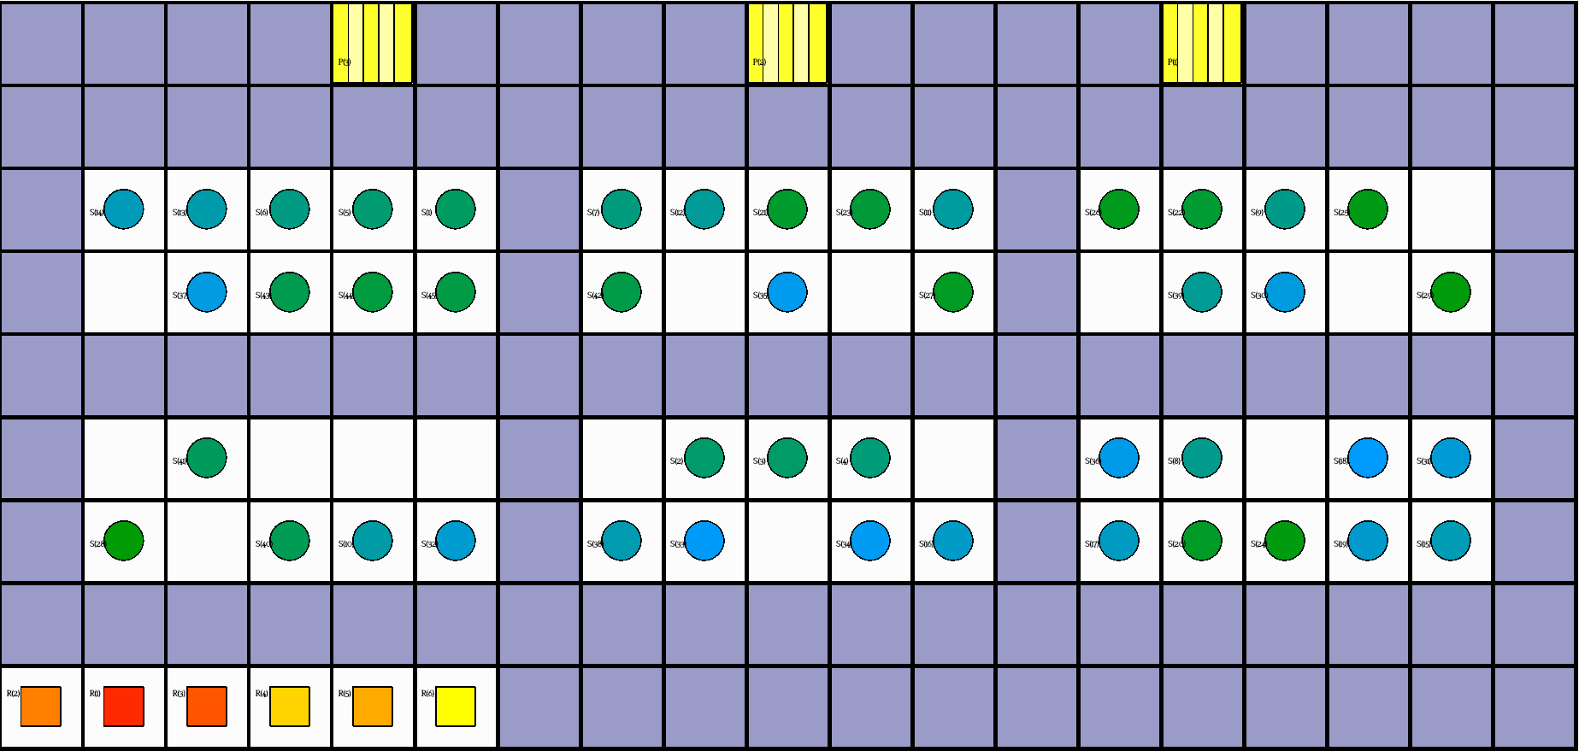

Slide 5
Explanation of asprilo and MAPF
asprilo
Benchmark environment
Various problem Domains(A,B,C,M)

Slide 6
Explanation of asprilo and MAPF
asprilo
Benchmark environment
Various problem Domains(A,B,C,M)
Multi Agent Path Finding

Slide 7
Details of the Merger
2.1 Basics

Slide 8
Basics
plan_occurs/3 & step_move/4 & step_pickup/4 & step_putdown/4

Slide 9
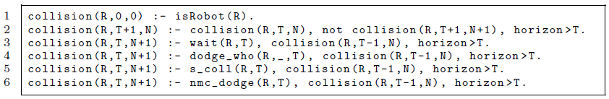
Basics
plan_occurs/3 & step_move/4 & step_pickup/4 & step_putdown/4
collision/3

Slide 10
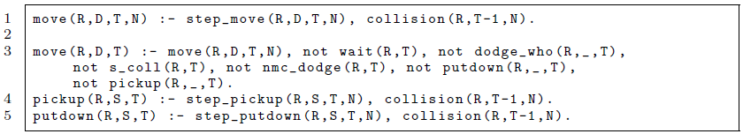
Basics
plan_occurs/3 & step_move/4 & step_pickup/4 & step_putdown/4
collision/3
move/4
move/3 & pickup/3 & putdown/3

Slide 11
Basics
plan_occurs/3 & step_move/4 & step_pickup/4 & step_putdown/4
collision/3
move/4
move/3 & pickup/3 & putdown/3
position/3 & carries/3

Slide 12
Details of the Merger
2.1 Basics
2.2 Use cases
2.2.1 vertex collision

Slide 13


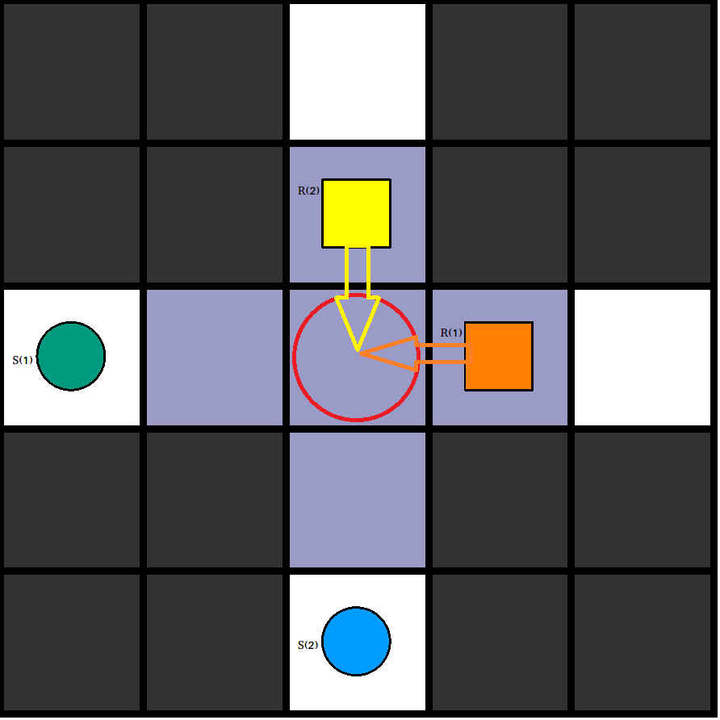
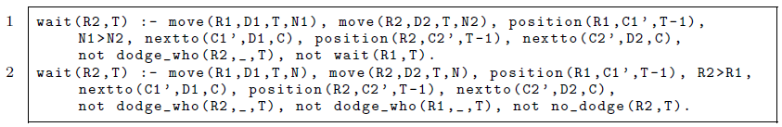
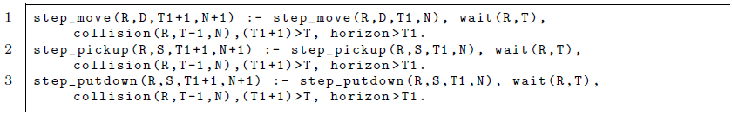
Vertex collision
wait/2

Slide 14
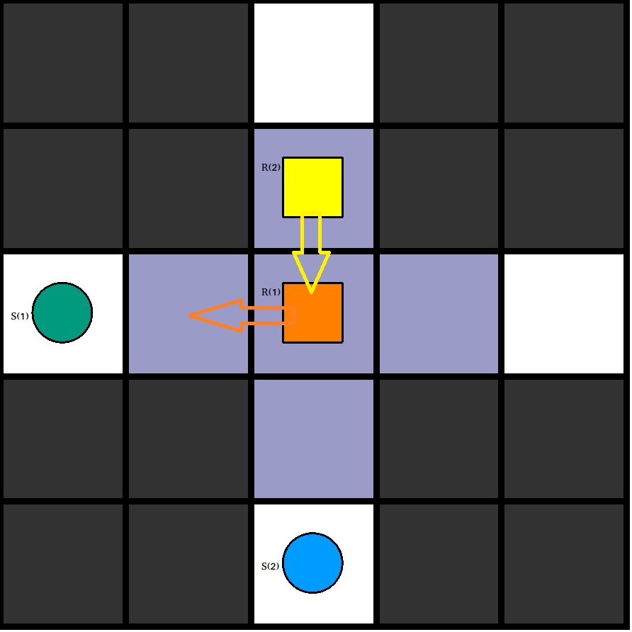
Vertex collision
wait/2

Slide 15
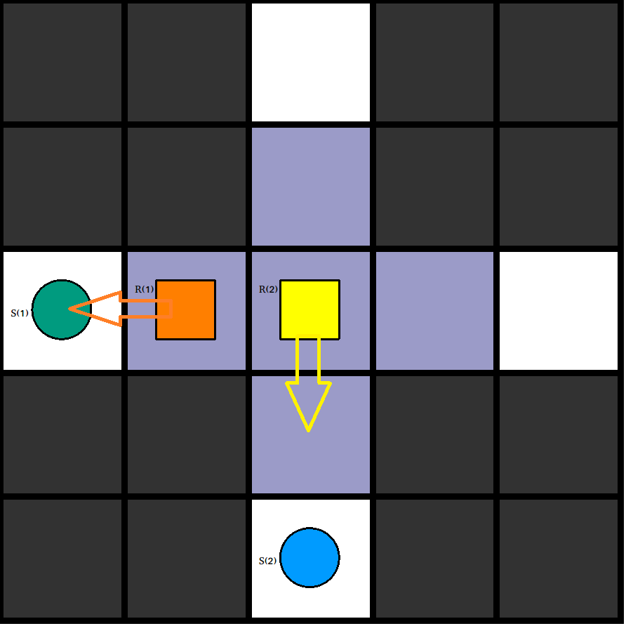
Vertex collision
wait/2

Slide 16
Details of the Merger
2.1 Basics
2.2 Use cases
2.2.1 vertex collision
2.2.2 edge collision

Slide 17
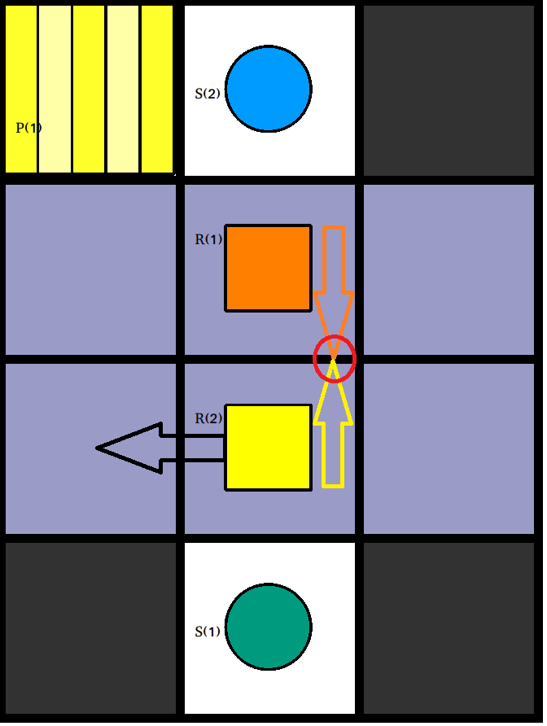
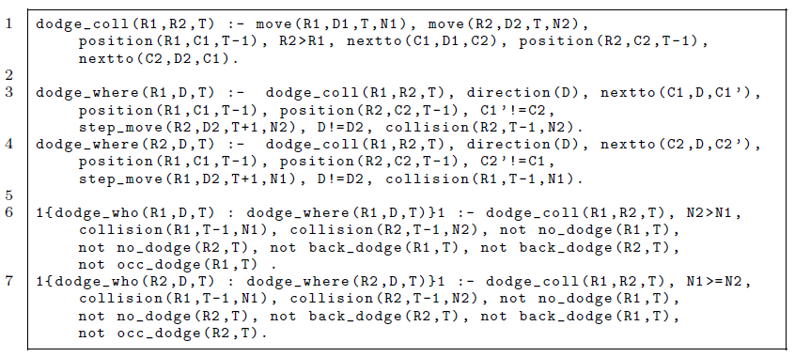
Edge collision
dodge_coll/3
dodge_where/3
dodge_who/3

Slide 18
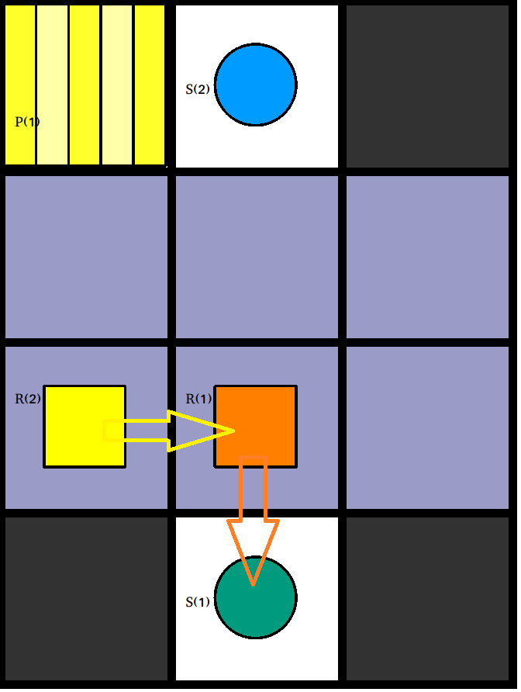
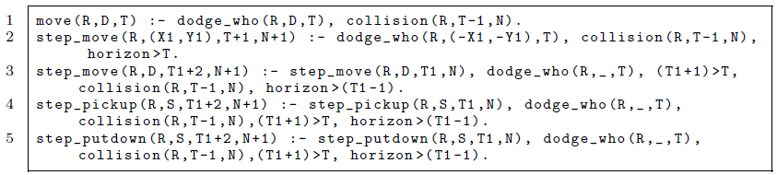
Edge collision
dodge_coll/3
dodge_where/3
dodge_who/3

Slide 19
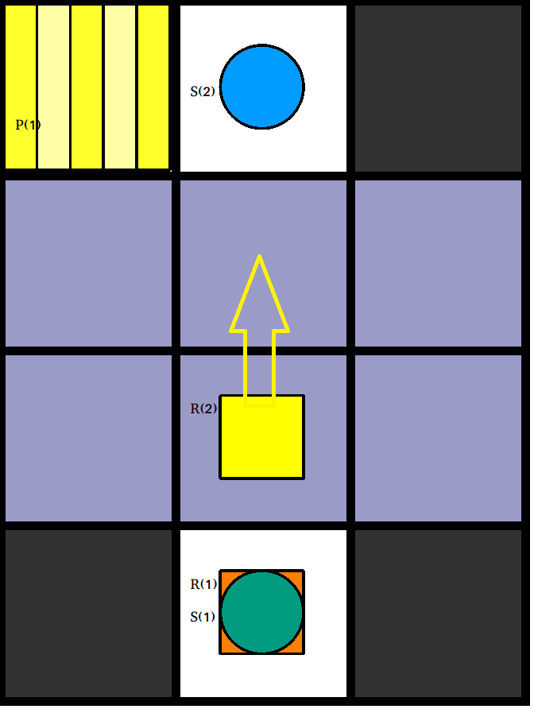
Edge collision
dodge_coll/3
dodge_where/3
dodge_who/3

Slide 20
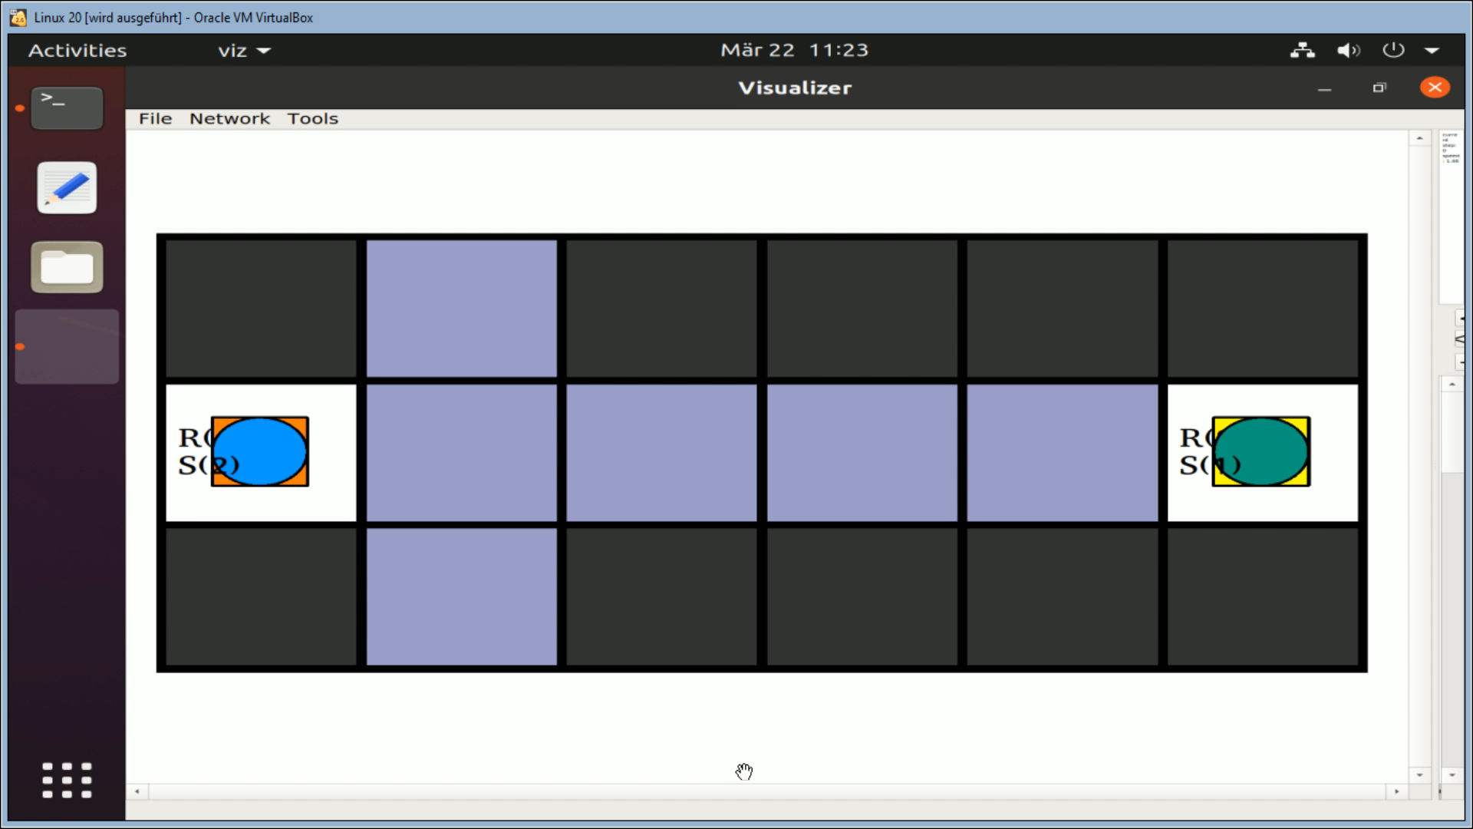

Slide 21
Details of the Merger
2.1 Basics
2.2 Use cases
2.2.1 vertex collision
2.2.2 edge collision
2.2.3 issues of the B domain

Slide 22
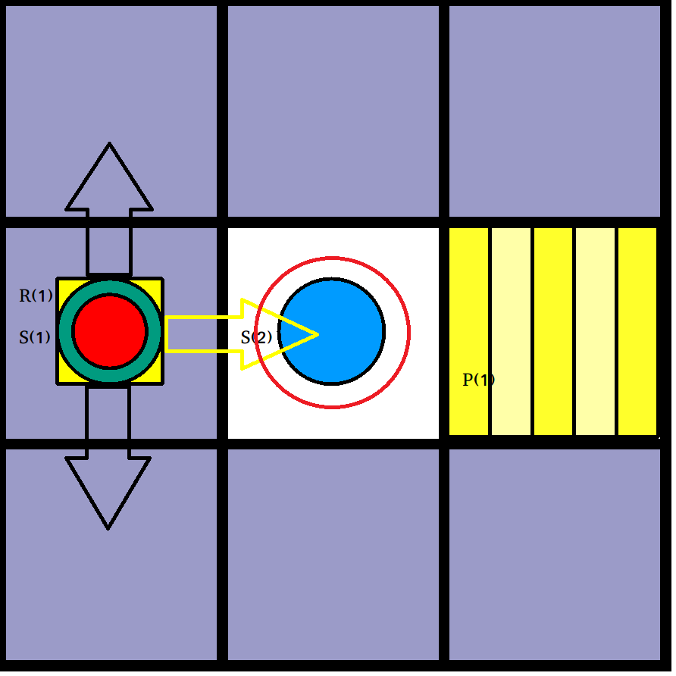

Slide 23
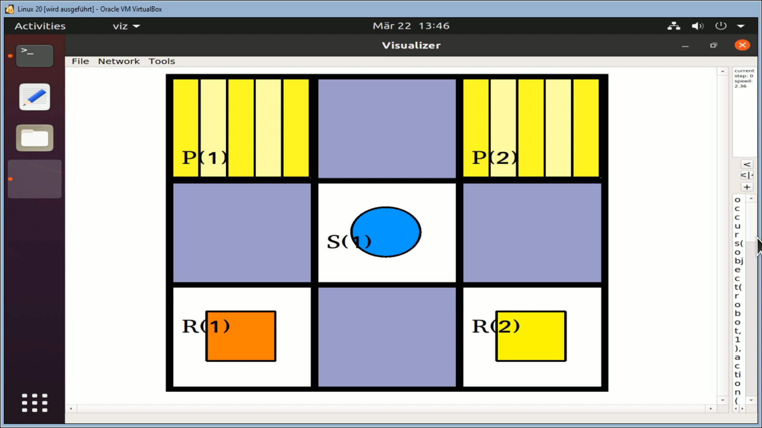

Slide 24
Results and Comparison
B. Group 1 | Group 1 | Group 2 | Group 3 | Group 4 | Group 5 | Horizon | #Robots
1 | 0.027s | 0.457s | 0.034s | 0.058s | 0.018s | 5 | 2
2 | 0.125s | UNSAT | 0.017s | UNSAT | 0.016s | 3 | 4
3 | 209.25 | 2.903s | 0.072s | 0.065s | 0.094s | 7-14 | 2
4 | 55.426s | KILLED | 0.179 | UNSAT | UNSAT | 9 | 8
B. Group 2 | Group 1 | Group 2 | Group 3 | Group 4 | Group 5 | Horizon | #Robots
1 | 0.032s | 0.972s | 0.028s | 0.029s | UNSAT | 5-7 | 2
2 | 0.014s | 0.105s | 0.012s | 0.029s | UNSAT | 4 | 2
3 | 4.949s | 6.666s | 0.051s | 0.041s | 0.107s | 6-9 | 4
4 | UNSAT | 4.578s | UNSAT | UNSAT | UNSAT | 15 | 2

Slide 25
B. Group 3 | Group 1 | Group 2 | Group 3 | Group 4 | Group 5 | Horizon | #Robots
1 | UNSAT | KILLED | 0.902s | 0.180s | 0.309s | 12-17 | 4
2 | 187.834s | KILLED | 0.129s | 0.418s | UNSAT | 9 | 8
3 | 6.442s | KILLED | 0.229s | 0.450s | UNSAT | 10(12) | 5
4 | 419.762s | KILLED | 0.229s | 3.433s | UNSAT | 21(23) | 6
B. Group 4 | Group 1 | Group 2 | Group 3 | Group 4 | Group 5 | Horizon | #Robots
1 | UNSAT | UNSAT | UNSAT | 0.037s | UNSAT | 5 | 3
2 | KILLED | UNSAT | 0.442s | 0.352s | UNSAT | 19 | 2
3 | 0.350s | UNSAT | 0.058s | 0.191s | 0.191s | 9(14) | 3
4 | 1.065s | 7.669s | 0.084s | 0.064 | 0.152s | 15-16 | 2
B. Group 5 | Group 1 | Group 2 | Group 3 | Group 4 | Group 5 | Horizon | #Robots
1 | UNSAT | UNSAT | UNSAT | 0.047s | 0.127s | 6-10 | 4
2 | 0.070s | 3.000s | 0.032s | 0.024s | 0.060s | 4 | 3
3 | KILLED | KILLED | KILLED | UNSAT | KILLED | 40 | 50
4 | KILLED | KILLED | KILLED | UNSAT | KILLED | 100 | 30

Slide 26
Conclusion
General
Special benchmarks and their problems

Slide 27
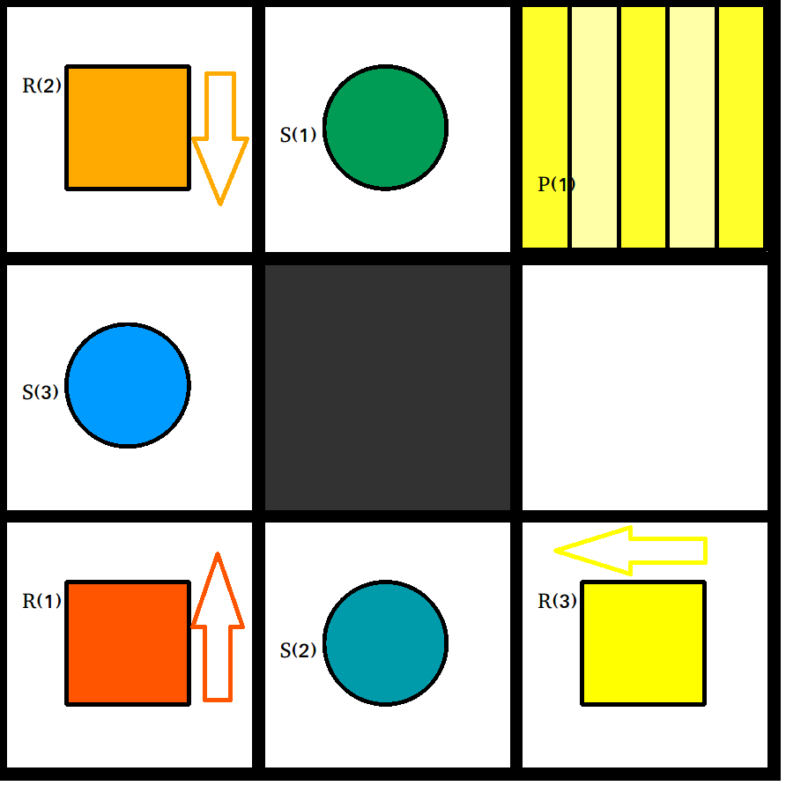

Slide 28
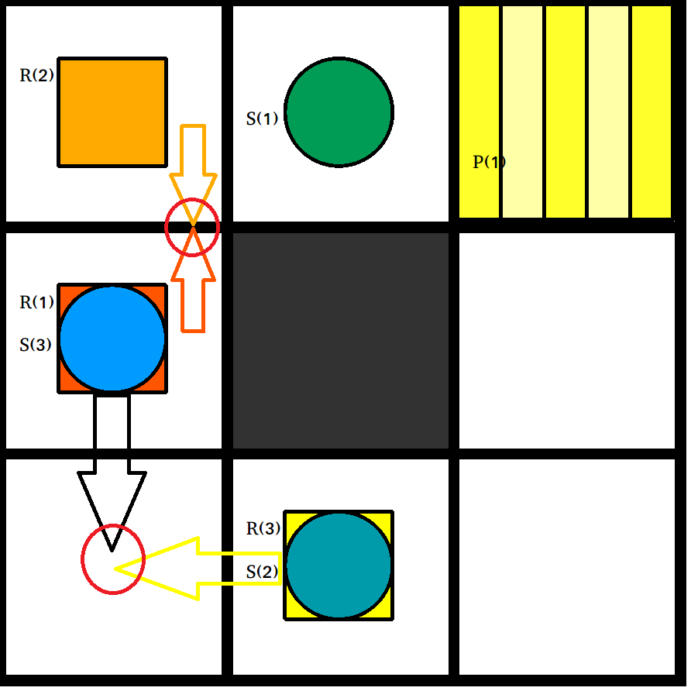

Slide 29
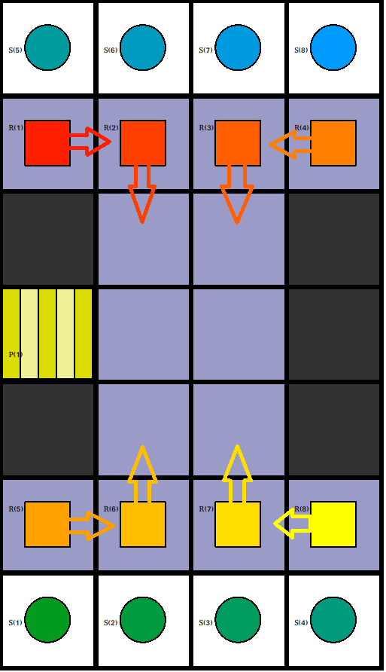

Slide 30
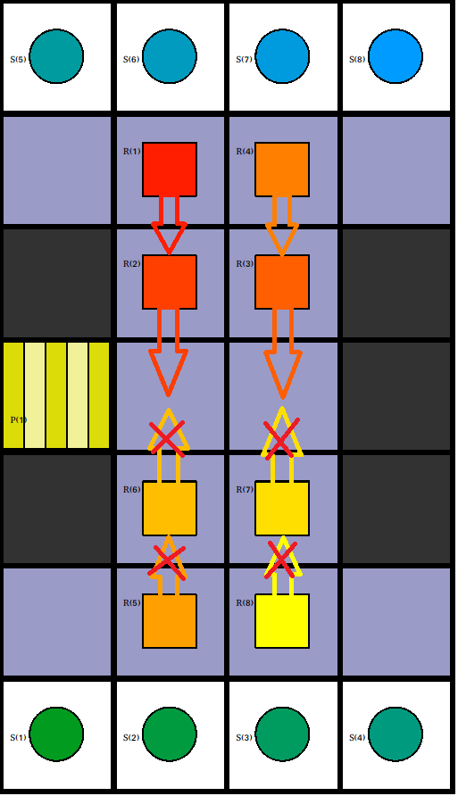

Slide 31
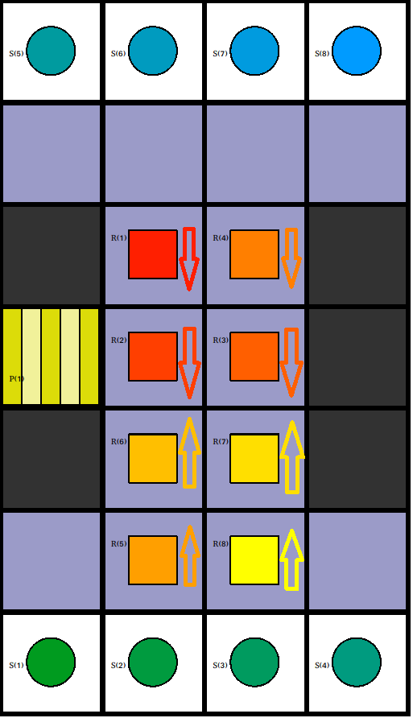

Slide 32
Plans going forward
Fixes for known “bugs”
shelf collisions
Adding new features

Slide 33
Questions?

Slide 34
References
Group 2 (Marcus & Marcus) : https://github.com/Zard0c/ProjektMAPF
Group 1 (Adrian) : https://github.com/salewsky/Plan-Merging
Group 3 (Niklas & Marius) : https://github.com/NikKaem/mapf-project
Group 4 (Tarik) : https://github.com/tramadan-up/asprilo-project
Group 5 (Tom, Julian, Hannes) : https://github.com/tzschmidt/PlanMerger
Experimenting with robotic intra-logistics domains : https://arxiv.org/abs/1804.10247
Picture 1: Experimenting with robotic intra-logistics domains, page 7
Picture 2-4 : Group 2, benchmark 5
Picture 5-7 : Group 2, benchmark 6
Picture 8 : small benchmark made for this presentation
Picture 9-11: Group 4, shared benchmark 1
Picture 12-14: Group 3, benchmark 6
Table 1-5: Group 2 report paper, page 26 – 28
Video 1: video on benchmark 16_mod2 from group 2
Video 2: video on benchmark 17 from group 2

